Slide 1

Consultancy and Professional Practice
W3: Data collection and diagnostic issues
Dr Lukas Wallrich (l.wallrich@bbk.ac.uk), partly based on slides by Alistair Cummings

Slide 2
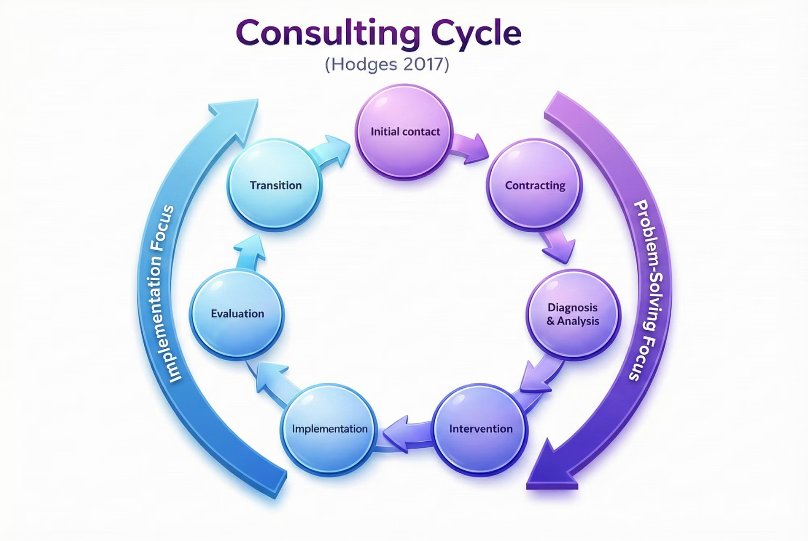
The Consultancy Cycle: getting into the problem
Contracting gave us initial ideas and initial data - now we need more!

Slide 3

Block's Steps for
Structured Discovery
Steps 3-4
Steps 5
Step 6
Select the dimensions to be studied & who will be involved
Select the method(s)
Do Discovery
Steps 7-9
Process the data, make sense of it.
Contracting should already have ensured access to the right people, and clarity on the initial problem

Slide 4
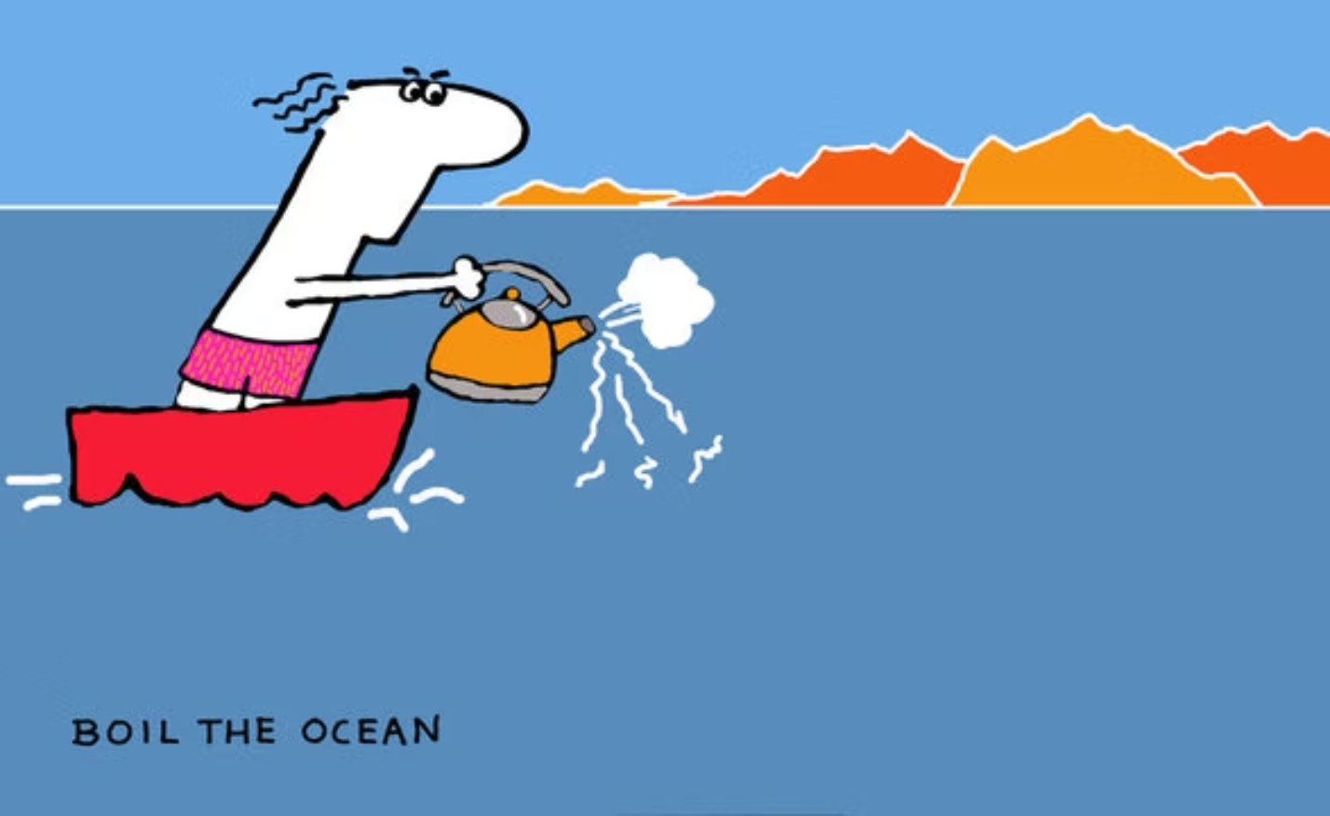

Approaches to diagnosis
Inductive
Deductive / hypothesis-driven
Won't miss the best solution – if you ever get there
Efficient – if you start in the right area
Costly – consultants often brought in to avoid this
Risky – confirmation bias kicks in
Notes:
Experienced consultants balance hypothesis-testing with authentic openness to disconfirming evidence. They actively seek information that challenges their assumptions, not merely data that confirms pre-existing beliefs.

Slide 5

Mindset: Action vs Research Approach (Block)
A crucial mindset shift for consultants that come out of academia.
Research Approach
Action Approach
Interested in all factors comprehensively
Focus on factors under client's control
Complete and systematic coverage
Sufficient insight to decide next steps
Work independently for objectivity
Deep client involvement throughout
Eliminate bias rigorously
Use feelings alongside data strategically
Maintain neutrality about outcomes
Deeply concerned with client attitudes
The key tension: be efficient without sacrificing rigour.

Slide 6
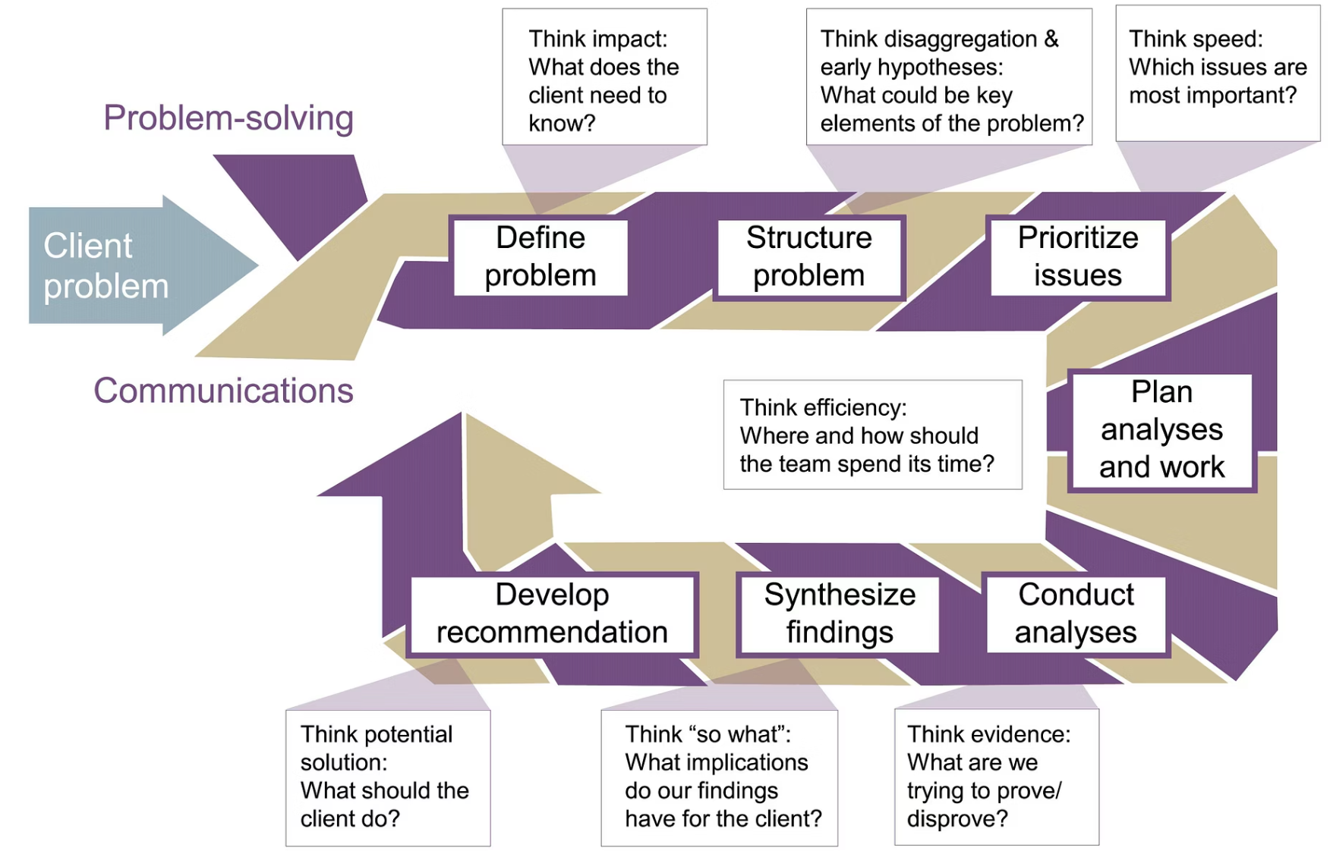
Strongly hypothesis-driven consulting:
McKinsey's Seven-Step Problem-Solving Process
Analyses start pretty late, planning is key.
Highly efficient … but only if your early framing accurately captures the situation.

Slide 7
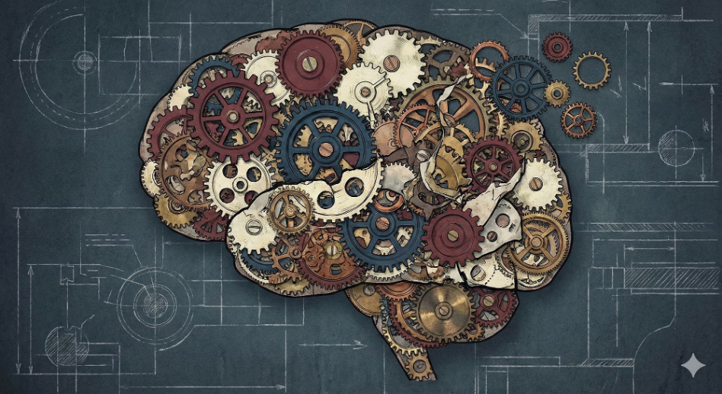



Three Distinct Purposes for Collecting Data
Build Understanding
Engage the Organisation
Enable Action
Discover potential solutions
Begin "unfreezing" and building momentum for change across stakeholder groups.
You're paid consultants, not neutral 'scientists’ – and clients will let you know
Assess existing ideas
Gain clarity on cause and effect
Learn about organisational culture and deeper assumptions
Critical insight: Gathering data raises expectations; it's never merely diagnosis.
These three purposes often exist in tension. Attention is selective; data gathering is an intervention.

Slide 8



Your reflection
Do you naturally approach problems inductively or deductively? When has that preference led to success—or trouble?
COMING UP NEXT
Planning data collection - who and what?
Notes:
It's not always "client has problem, calls consultant." Sometimes consultants create the problem. We'll look at farming versus hunting, and a framework called the Pyramid of Trust.

